Slide 1
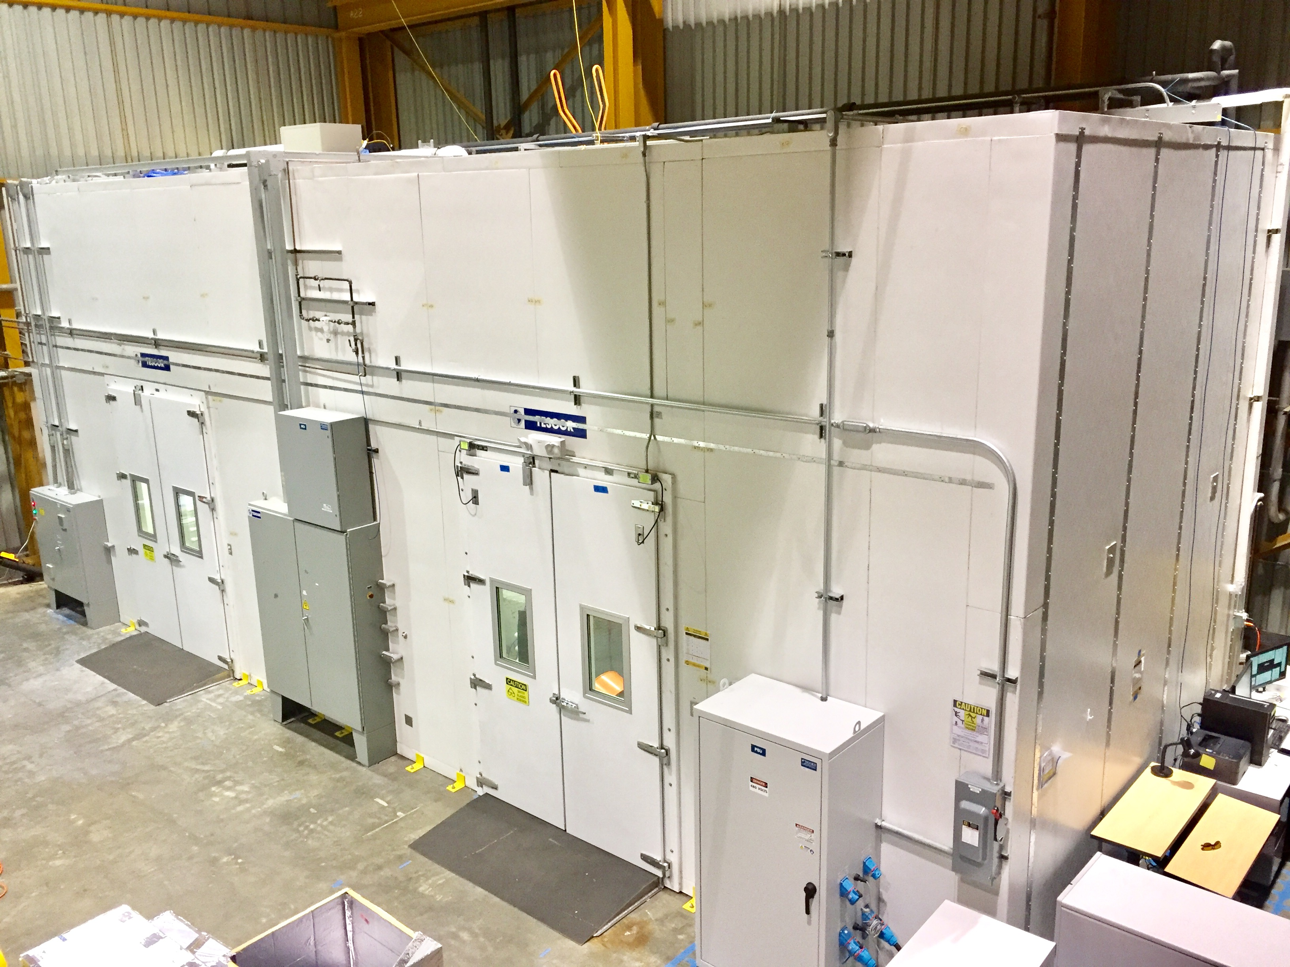
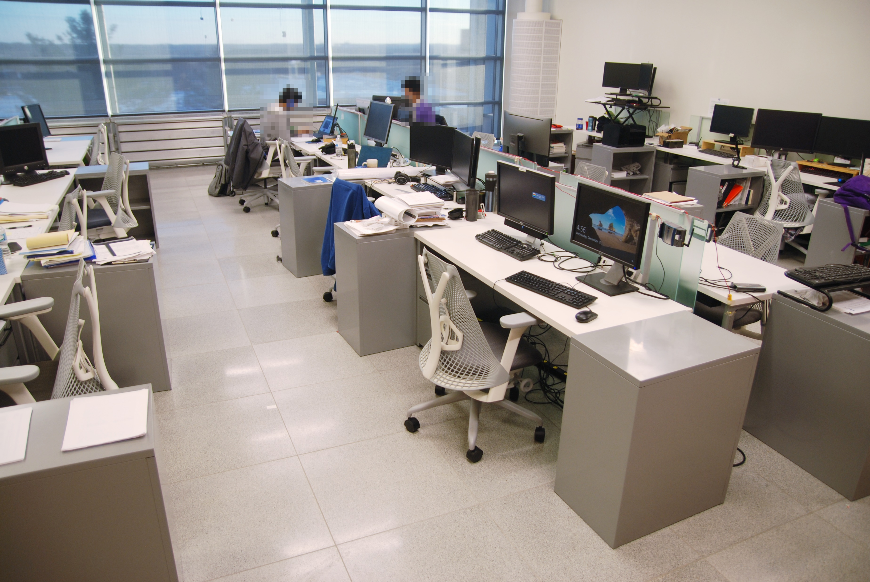
Background
Comfortable thermal indoor environments to occupants
Health
Overall satisfaction
Productivity
Extensive research on human thermal comfort since 1960s
Empirical thermal comfort models
Predicting the average comfort level
International standards (e.g., ASHRAE standard 55)

Slide 2
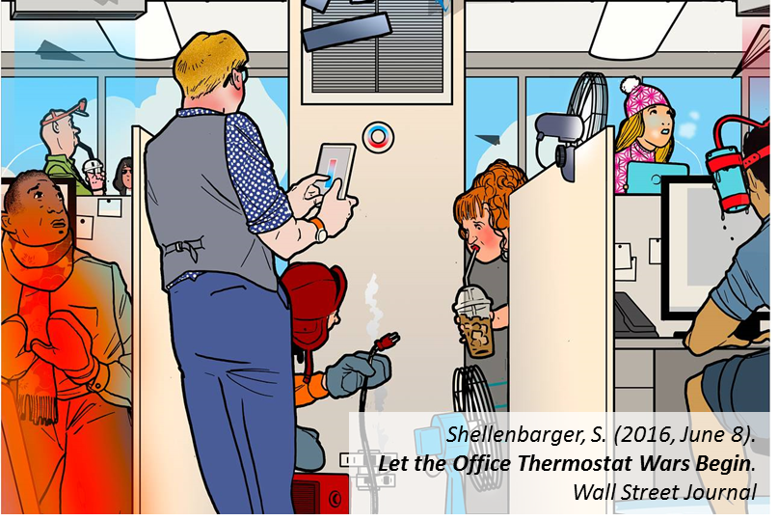
Background
Comfort?
Energy?

Slide 3
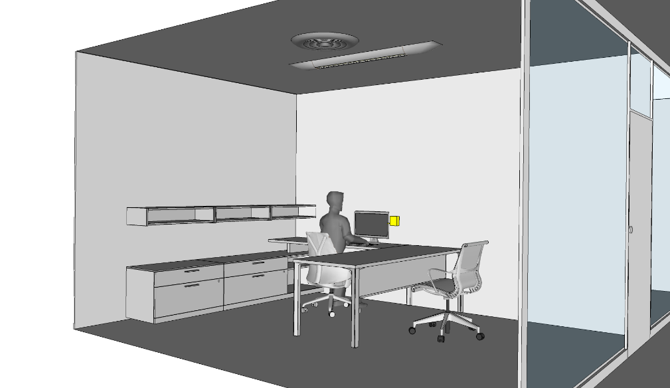

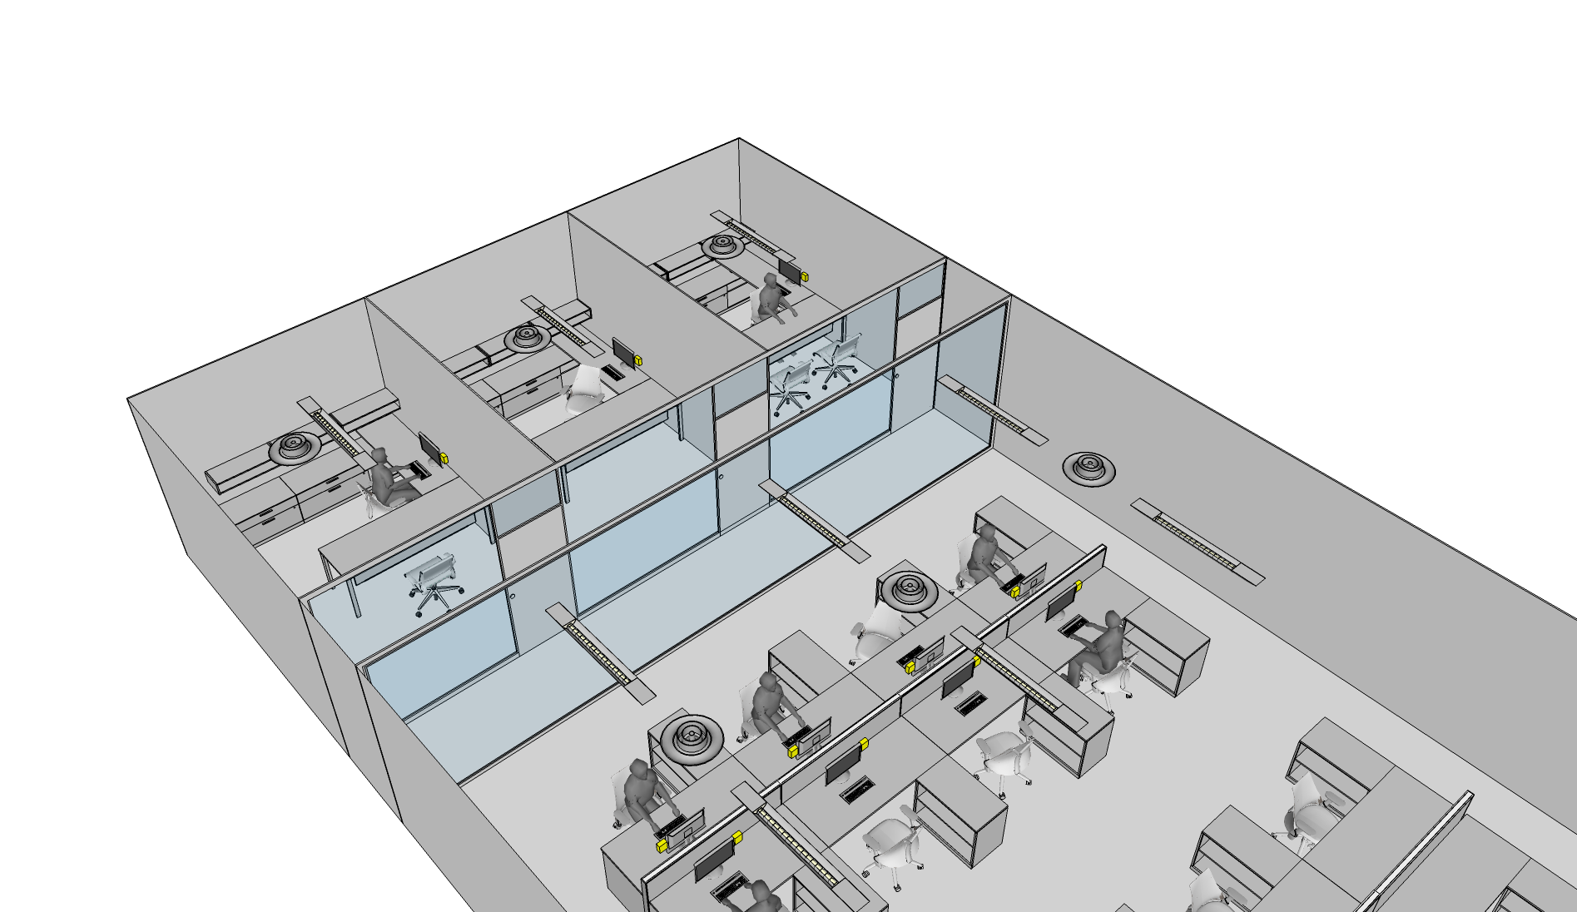
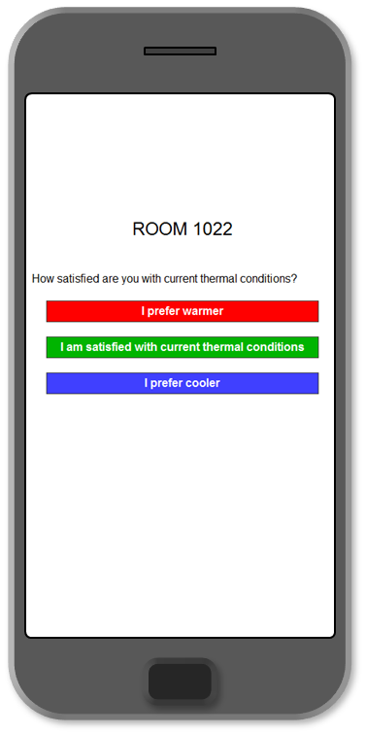
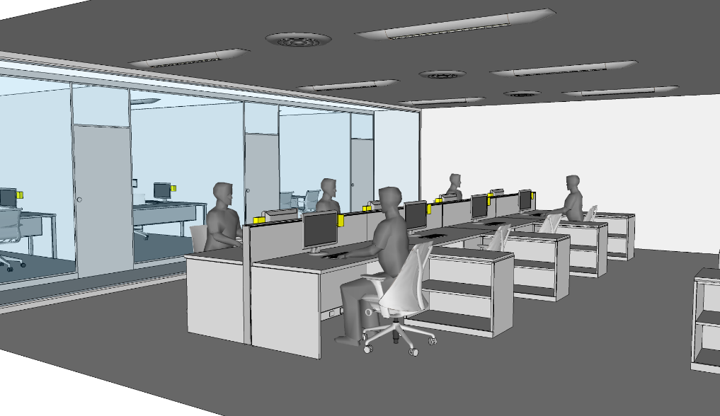
Vision
Smart and occupant-centric HVAC systems
Building occupants in sensing/control framework (human-in-the-loop)
Self-tuned by learning their occupants
Optimal decisions on equipment operation
Customized indoor environmental conditions
Private Office
Learning Module
- Occupant Preferences
- Occupancy Schedule
- Occupant Behavior
Data Handling
- Weather
- Indoor Conditions
- Occupancy
- Occupant Feedback
- System Status
- Utility Price
Weather
Energy Grid
Local Sensing
- Temperature
- Occupancy
- Physiological Info.
Control Module
- Stochastic Opt. Control
- Multi-Agent Architecture
- Distributed Optimization
Learning method
Optimal control strategy
HVAC equipment
User-interface
Sensing device
Open-plan Office
Sensor Data
Occupant Feedback

Slide 4
Learning Occupants’ Thermal Comfort

Slide 5
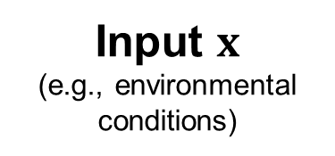
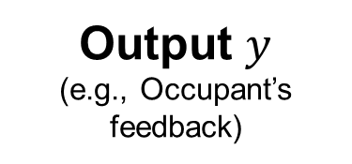
Learning Occupants’ Thermal Preferences
Machine learning / data-driven modeling techniques
Input $x$
(e.g., environmental conditions)
Model
Output $y$
(e.g., Occupant’s feedback)
Good model structure / learning algorithm
Effective input variables
Focused on prediction performance / accuracy
Lack of consideration for real-world implementations

Slide 6
Learning Occupants’ Thermal Preferences
I have knowledge on human thermal comfort to some extent. Can I use this knowledge to compensate for the lack of data?
Are individuals totally different from each other? Should I train a separate model for each individual from scratch?

Slide 7
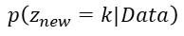
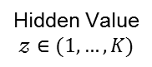
Overall Process for Learning
In the model, explicitly encode my key hypothesis: “Different people prefer different thermal condition”
Based on a Large Dataset
Developing a Generalized Model for a Large Population
Learning an Individual Occupant
Hidden Value
$$𝓏∈(1,…,K)$$
1
1
3
2
Target Occupant
?
?
?
?
Cluster 1
Cluster 3
$$p\left(z_{new}=k|Data\right)$$
Cluster 2
Occupants in
the Large Dataset
Sub-Model for Cluster 1
Sub-Model for Cluster 2
Sub-Model for Cluster 3
Mixture of Models
Introduce equations in PMV model with additional correction parameters as my prior knowledge

Slide 8
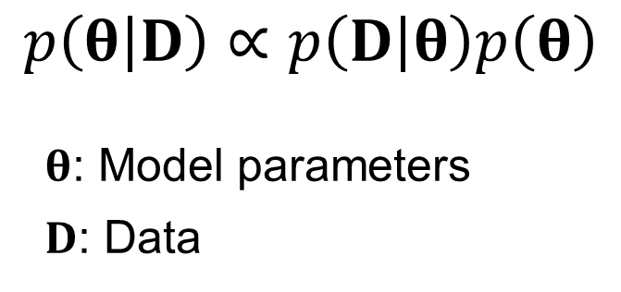
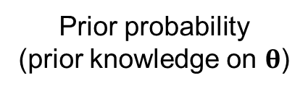
Bayesian Modeling Approach
Bayes’ Rule
Data likelihood
Prior probability
(prior knowledge on $θ$)
$$p\left(θ | D\right)∝p\left(D | θ\right)p\left(θ\right)$$
$θ$: Model parameters
$D$: Data
Posterior probability
(Not a point estimation)
Encode our prior knowledge
Quantify the model uncertainty
Easily introduce hidden (unobserved) variables
Seamlessly combine data from heterogeneous sources

Slide 9

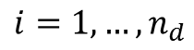


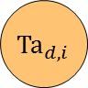
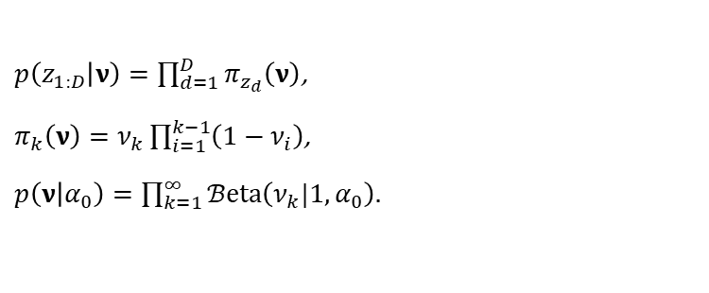
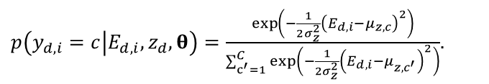
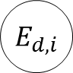

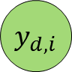
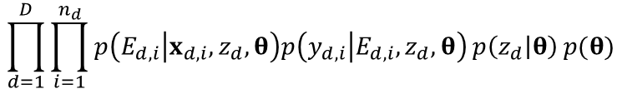

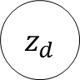
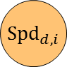
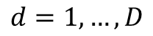
Generalized Thermal Preference Model
$$d=1,…,D$$
Joint probability:
$$\prod_{d=1}^{D}{\prod_{i=1}^{n_{d}}{p\left(E_{d,i} | x_{d,i},z_{d},θ\right)p\left(y_{d,i} | E_{d,i},z_{d},θ\right)}p\left(z_{d} | θ\right)}p(θ)$$
$${Ta}_{d,i}$$
$$i=1,…,n_{d}$$
$${MRT}_{d,i}$$
Equations in PMV model with additional correction parameters
$${RH}_{d,i}$$
$$E_{d,i}$$
$$y_{d,i}$$
$${Spd}_{d,i}$$
Linear discriminant analysis formulation
$p\left(y_{d,i}=c | E_{d,i},z_{d},θ\right)=\frac{\exp\left(−\frac{1}{2σ_{z}^{2}}{\left(E_{d,i}−μ_{z,c}\right)}^{2}\right)}{\sum_{c^{′}=1}^{C}{\exp\left(−\frac{1}{2σ_{z}^{2}}{\left(E_{d,i}−μ_{z,c^{′}}\right)}^{2}\right)}}$.
$${Met}_{d,i}$$
$${Clo}_{d,i}$$
Dirichlet process (DP) prior
$$z_{d}$$
$p\left(z_{1:D} | ν\right)=\prod_{d=1}^{D}{π_{z_{d}}\left(ν\right)}$,
$π_{k}\left(ν\right)=ν_{k}\prod_{i=1}^{k−1}{\left(1−ν_{i}\right)}$,
$p\left(ν | α_{0}\right)=\prod_{k=1}^{∞}{ℬeta\left(ν_{k}|1,α_{0}\right)}$.
$$θ$$

Slide 10
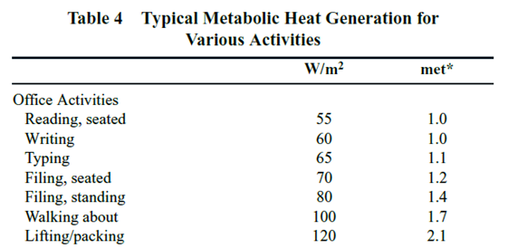
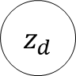
Generalized Thermal Preference Model
$$d=1,…,D$$
Subset of ASHRAE RP-884 DB
HVAC conditioned buildings in North America
# people: 259 / # data points: 1712
$${Ta}_{d,i}$$
$$i=1,…,n_{d}$$
$${MRT}_{d,i}$$
$${RH}_{d,i}$$
$$E_{d,i}$$
$$y_{d,i}$$
$${Spd}_{d,i}$$
$${Met}_{d,i}$$
$${Clo}_{d,i}$$
$$z_{d}$$
$$θ$$

Slide 11
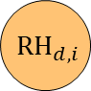

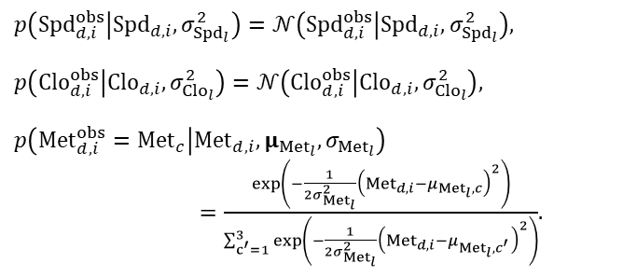

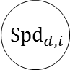

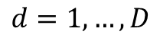
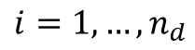





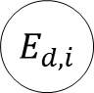


Generalized Thermal Preference Model
$$d=1,…,D$$
Error-in-variables
$${Ta}_{d,i}$$
$$i=1,…,n_{d}$$
“The true values were not measured, but there are relationships between the observed and the true values.”
$${MRT}_{d,i}$$
$${RH}_{d,i}$$
$$E_{d,i}$$
$$y_{d,i}$$
$${Spd}_{d,i}^{obs}$$
$${Spd}_{d,i}$$
$p\left({Spd}_{d,i}^{obs} | {Spd}_{d,i},σ_{{Spd}_{l}}^{2}\right)=𝒩\left({Spd}_{d,i}^{obs} | {Spd}_{d,i},σ_{{Spd}_{l}}^{2}\right)$,
$p\left({Clo}_{d,i}^{obs} | {Clo}_{d,i},σ_{{Clo}_{l}}^{2}\right)=𝒩\left({Clo}_{d,i}^{obs} | {Clo}_{d,i},σ_{{Clo}_{l}}^{2}\right)$,
$p\left({Met}_{d,i}^{obs}={Met}_{c} | {Met}_{d,i},μ_{{Met}_{l}},σ_{{Met}_{l}}\right)$ $=\frac{\exp\left(−\frac{1}{2σ_{{Met}_{l}}^{2}}{\left({Met}_{d,i}−μ_{{Met}_{l},c}\right)}^{2}\right)}{\sum_{c^{′}=1}^{3}{\exp\left(−\frac{1}{2σ_{{Met}_{l}}^{2}}{\left({Met}_{d,i}−μ_{{Met}_{l},c^{′}}\right)}^{2}\right)}}$.
$${Met}_{d,i}^{obs}$$
$${Met}_{d,i}$$
$${Clo}_{d,i}^{obs}$$
$${Clo}_{d,i}$$
$$z_{d}$$
$$θ$$

Slide 12
Training Algorithm
5,454 latent variables including 59 model parameters, 259 hidden characteristics
Automatic Differentiation Variational Inference (ADVI) algorithm
Suitable for high-dimensional problems
Significantly faster than typical Markov chain Monte Carlo (MCMC) methods ex) Training time with 100 CPUs ≈ 1.5 hour

Slide 13
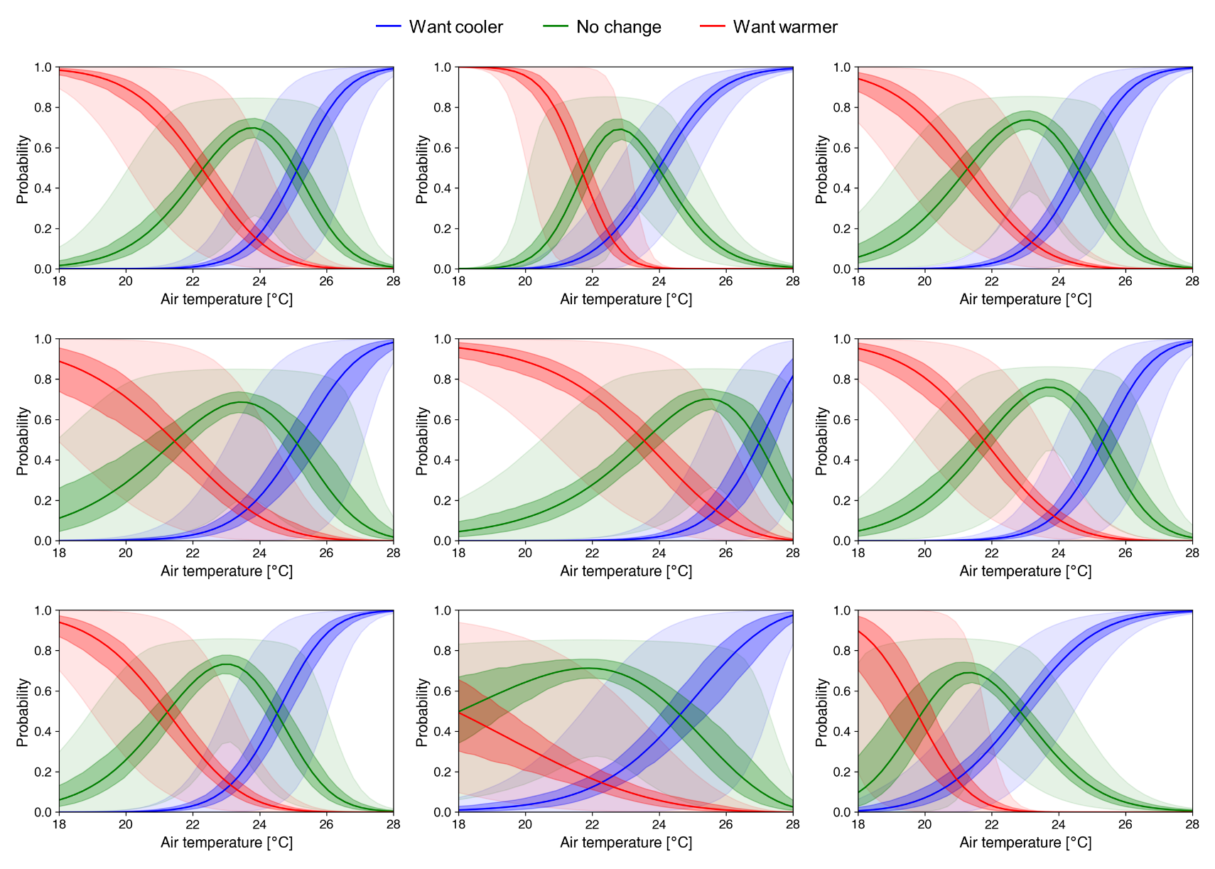
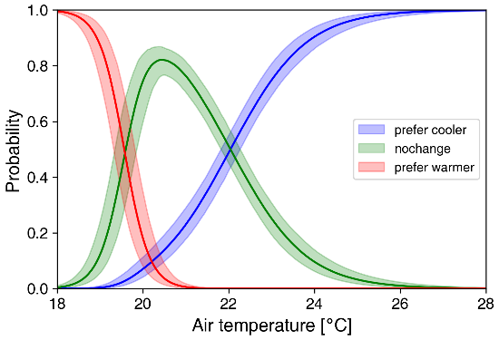
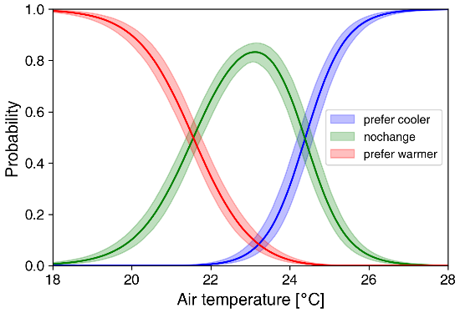
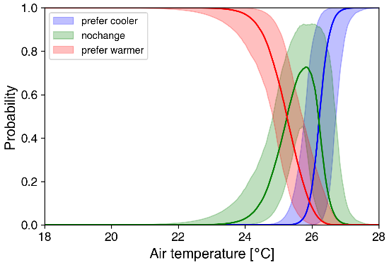
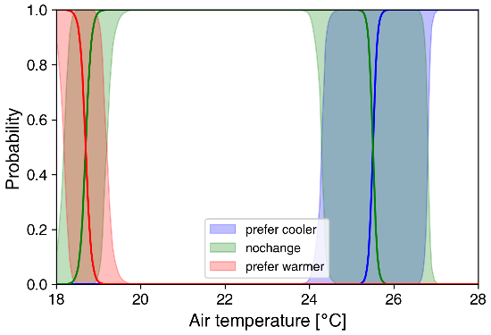
Generalized Thermal Preference Model

Slide 14
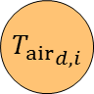
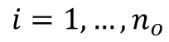
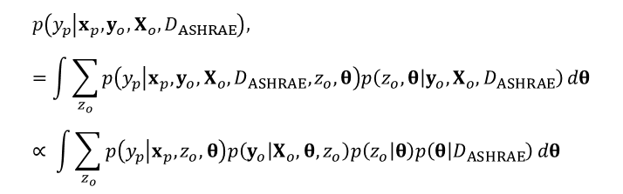


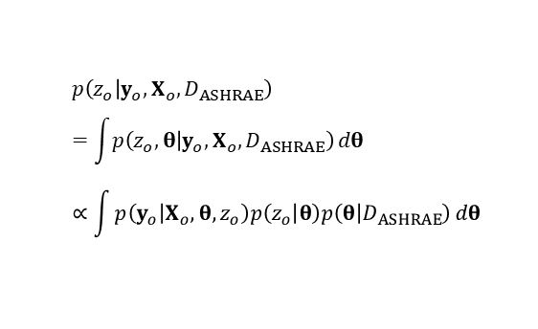
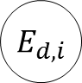


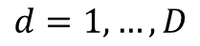
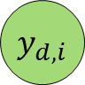

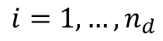
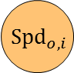
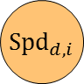


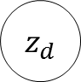





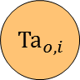
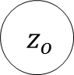
Personalized Thermal Preference Models
$${ D}_{ASHRAE}$$
$$θ$$
$$d=1,…,D$$
Probability of the occupant belonging to each cluster
$${T_{air}}_{d,i}$$
$$i=1,…,n_{d}$$
$$z_{o}$$
$${MRT}_{d,i}$$
$$p\left(z_{o} | y_{o},X_{o},D_{ASHRAE}\right) \\ =\int{p\left(z_{o}, θ | y_{o},X_{o},D_{ASHRAE}\right)}dθ \\ ∝\int{p\left(y_{o} | X_{o},θ,z_{o}\right)p\left(z_{o} | θ\right)p\left(θ | D_{ASHRAE}\right)}dθ$$
$${RH}_{d,i}$$
$${Ta}_{o,i}$$
$$E_{d,i}$$
$$y_{d,i}$$
$${MRT}_{o,i}$$
$${Spd}_{d,i}$$
$${RH}_{o,i}$$
Predicting the thermal preference of the occupant
$${Met}_{d,i}$$
$$E_{o,i}$$
$$y_{o,i}$$
$${Spd}_{o,i}$$
$${Clo}_{d,i}$$
$$p\left(y_{p} | x_{p},y_{o},X_{o},D_{ASHRAE}\right), \\ =\int{\sum_{z_{o}}{p\left(y_{p} | x_{p},y_{o},X_{o},D_{ASHRAE},z_{o},θ\right)p\left(z_{o},θ | y_{o},X_{o},D_{ASHRAE}\right)}}dθ \\ ∝ \int{\sum_{z_{o}}{p\left(y_{p} | x_{p},z_{o},θ\right)p\left(y_{o} | X_{o},θ,z_{o}\right)p\left(z_{o} | θ\right)p\left(θ | D_{ASHRAE}\right)}}dθ$$
$${Met}_{o,i}$$
$$z_{d}$$
$${Clo}_{o,i}$$
$$i=1,…,n_{o}$$
$$θ$$

Slide 15
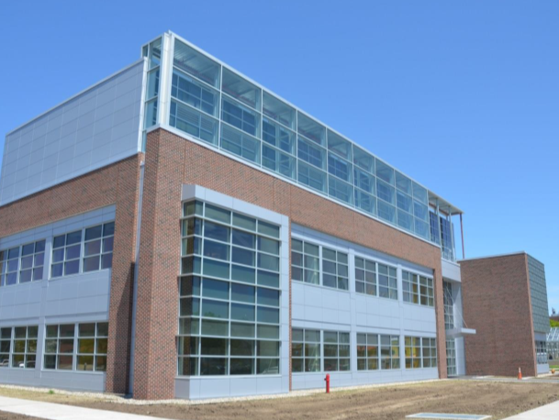

Experimental Study
Location: 3 south-facing private offices
Period: October and November 2017
9 test-subjects
Exterior
Interior

Slide 16
Inferred Personalized Profiles

Slide 17

Prediction Performance
Proposed
Logistic regression
S. Lee, P. Karava, A. Tzempelikos, I. Bilionis. “Inference of thermal preference profiles for personalized thermal environments with actual building occupants.” Building and Environment, 2019, 148:714-729.
S. Lee, I. Bilionis, P. Karava, A. Tzempelikos. “A Bayesian approach for probabilistic classification and inference of occupant thermal preferences in office buildings.” Building and Environment, 2017, 118:323-343.

Slide 18
Smart User-Interface

Slide 19
Smart User-Interface
Regular or random feedback requests
Requesting occupants’ thermal comfort related responses
Ideal way to minimize bias
Intrusive and not practical in real buildings
Prefer warmer
Satisfied
Prefer cooler
Temperature

Slide 20
Smart User-Interface
Participatory interface
Voluntarily provided/submitted feedback when occupants want
Participation, a type of behavior, could be affected by multiple factors (comfort/discomfort, workload, interface design, control logic, expectation)
Sampling bias & cannot guarantee collection of necessary data
Prefer warmer
Few “Satisfied” responses
Less data points from relatively comfortable conditions
Satisfied
Prefer cooler
Temperature

Slide 21
Smart User-Interface
Practical and effective feedback collection strategy
Mainly rely on occupants’ participation (participatory responses)
How to resolve the sampling bias issue
Additionally request responses only when they are truly needed to learn effectively (smart request algorithm)
How to quantify the expected value (information gain) of a request

Slide 22


Experiment
Mar. – Apr. 2019
Three private offices
Five test-subjects
Two experimental setups

Slide 23
Experiment
Mar. – Apr. 2019
Three private offices
Five test-subjects
Two experimental setups
Setup 1: request
Pre-determined setpoint schedules
Feedback request every 30 minutes
Requested preference data
Setup 2: participatory
Participatory interface (no feedback request)
Temperature setpoint rule
“Prefer cooler” → decrease by 0.5 °C
“Satisfied” → no setpoint change
“Prefer warmer” → increase by 0.5 °C
Initial temperatures (25, 22.5, 20 °C)
Participatory preference data
Sch. | 1st | 2nd | 3rd | 4th | 5th | 6th | Lunch Break | 7th | 8th | 9th | 10th | 11th | 12th
1 | 25 | 24.5 | 24 | 23.5 | 23 | 22.5 |  | 22 | 21.5 | 21 | 20.5 | 20 | 19.5
2 | 19.5 | 20 | 20.5 | 21 | 21.5 | 22 |  | 22.5 | 23 | 23.5 | 24 | 24.5 | 25
3 | 27 | 26.5 | 26 | 25.5 | 25 | 24.5 |  | 24 | 23.5 | 23 | 22.5 | 22 | 21.5
4 | 21.5 | 22 | 22.5 | 23 | 23.5 | 24 |  | 24.5 | 25 | 25.5 | 26 | 26.5 | 27

Slide 24

Experiment

Slide 25





Resolving the Sampling Bias Issue
To deal with the sampling bias and properly learn an occupant’s thermal preference with participatory data
Revise the model structure to learn not only one’s preference but also how active the person is in using the interface.
Preference
Participation
Predictive probability distortion due to the sampling bias
Properly maintained uncertainty
1
2
3
Prediction error (expected cost)
Requested data (no sampling bias)
Participatory data (sampling bias)
Participatory data + Updated model
1
2
3

Slide 26
Smart Feedback Request Algorithm
Request occupants’ feedback, from time to time, when they are needed, to ensure or expedite the learning
Quantify the expected value (i.e., information gain) of requesting a response
Theory of Bayesian design of experiments provides a mathematical approach to solve the problem

Slide 27



Smart Feedback Request Algorithm
Added seven requested responses collected between 21.5 - 22.5 °C
Subject 1
Subject 1
Value of a feedback request at given temperature changes
Expected information gain (expected KL divergence)
Expected information gain (expected KL divergence)

Slide 28


Smart Feedback Request Algorithm
The average number of feedback requests in the scenarios
Expected KL Divergence
Request Only | 24
Proposed | 14.66
S. Lee, P. Karava, A. Tzempelikos, I. Bilionis. “A smart and less intrusive feedback request algorithm towards human-centered HVAC operation.” Building and Environment, 2020, 184:107190.

Slide 30


Measurements vs. EnergyPlus Results
Create datasets from the FRP for empirical validation of simulation tools, which has limited input uncertainty compared to real buildings.
Provide modeling Input document + operational data
Demonstrate with a detailed EnergyPlus model

Slide 31

Measurements vs. EnergyPlus Results – Room Temperature
Room air temperatures [°C]
Temperatures from the EnergyPlus model do not match the corresponding measurements
Decided to investigate envelope material & construction properties

Slide 32
Material Properties
 | Layers: exterior to Interior | Thickness |  | Conductivity |  | Density |  | Specific Heat |  | Thermal Resistance
 |  | m | inch | W/m-K | BTU.in/hr.ft².F | kg/m3 | lbs/ft³ | J/kg-K | BTU/lb∙°F | m²-K/W | ft²·h·°F/Btu
Exterior wall | Face brick (EnergyPlus Library) | 0.10 | 4.00 | 0.89 | 6.17 | 1920.00 | 119.86 | 790.00 | 0.19
 | Air Space (ASHRAE 90.1) |  |  |  |  |  |  |  |  | 0.16 | 0.90
 | Concrete Block Grout Filled only for 30% of the wall | 0.20 | 7.87 | 1.13 | 7.84 | 1218.00 | 76.04 | 920.00 | 0.22
 | Gypsum | 0.02 | 0.62 | 0.16 | 1.11 | 784.90 | 49.00 | 1090.00 | 0.26
 | Batt insulation (w. metal stud) - ASHRAE 90.1-2007 Effective R_value at 16 in o.c. | 0.09 | 3.50 | 0.09 | 0.64 | 4044.80 | 252.80 | 712.66 | 0.17
 | Gypsum | 0.02 | 0.62 | 0.16 | 1.11 | 784.90 | 49.00 | 1090.00 | 0.26
Exterior wall for 104 | Face brick (EnergyPlus Library) | 0.10 | 4.00 | 0.89 | 6.17 | 1920.00 | 119.86 | 790.00 | 0.19
 | Air Space (ASHRAE 90.1) |  |  |  |  |  |  |  |  | 0.16 | 0.90
 | Concrete Block Grout Filled only for 30% of the wall | 0.20 | 7.87 | 1.13 | 7.84 | 1218.00 | 76.04 | 920.00 | 0.22
 | Polyurethane (C.C. Spray Foam) | 0.05 | 2.00 | 0.02 | 0.17 | 32.00 | 2.00 | 920.00 | 0.22
 | Blown in cellulose with steel stud | 0.09 | 3.50 | 0.09 | 0.64 | 4044.80 | 252.80 | 712.66 | 0.17
 | Gypsum | 0.02 | 0.62 | 0.16 | 1.11 | 784.90 | 49.00 | 1090.00 | 0.26
Exterior wall for 204 | Face brick (EnergyPlus Library) | 0.10 | 4.00 | 0.89 |  | 1920.00 | 119.86 | 790.00 | 1.89
 | Air Space (ASHRAE 90.1) |  |  |  |  |  |  |  |  | 0.16 | 0.90
 | Concrete Block Grout Filled only for 30% of the wall | 0.20 | 7.87 | 1.13 | 7.84 | 1218.00 |  | 920.00 | 0.22
 | Gypsum | 0.02 | 0.62 | 0.16 | 1.11 | 784.90 | 49.00 | 830.00 | 0.20
 | Batt insulation (w. metal stud) - ASHRAE 90.1-2007 Effective R_value at 16 in o.c. | 0.09 | 3.50 | 0.09 | 0.64 | 4044.80 | 252.80 | 712.66 | 0.17
 | Polyiso rigid Foam Board | 0.05 | 2.00 | 0.03 | 0.18 | 32.00 | 2.00 | 920.00 | 0.22
 | Gypsum | 0.02 | 0.62 | 0.16 | 1.11 | 784.90 | 49.00 | 830.00 | 0.20

Slide 33
Sensors in the Walls
Temperature
Heat flux
Interior
Exterior
Gypsum
Batt Ins.
Concrete block
Air gap
Brick

Slide 34


Wall Material Property Estimation 1-D Finite Difference heat conduction model
Internal node heat diffusion equation
$$C_{p,i}ρ_{i}Δx\frac{dT_{i}}{dt}=\frac{k_{i}}{Δx}\left(T_{i+1}−2T_{i}+T_{i−1}\right)$$
discretization
Node temperatures
Boundary conditions
20 nodes (3 in gypsum, 6 in insulation, 10 in concrete block, 6 in face brick)
$x_{k+1}=A_{d}x_{k}+B_{d}u_{k}+w_{k}$
$y_{k}=C_{d}x_{k}+v_{k}$
$w_{k}\sim 𝒩\left(0,Q\right)$
$v_{k}\sim 𝒩\left(0,R\right)$
Process noise
Unconsidered factors influencing the dynamic
Model imperfection
Measurement noise

Slide 35


Wall Material Property Estimation 1-D Finite Difference heat conduction model
Prior distributions for the other material properties (Gamma)
mean: ~EP input values
95% interval: ~±30% of mean
Prior distribution for the density of the batt insulation layer (Gamma)
Very flat hierarchical
mean
~±30% of mean
Prior distribution for the density of the batt insulation layer (1/1000)

Slide 36


Estimation Data – 206 South Wall
Surface Temperatures
Heat Flux
Surface Temperature [°C]
Heat Flux [W/m2]

Slide 37

Estimation Results – 206 South Wall
Gypsum
Batt
Gypsum
CMU
Face Brick
Cp
[J/kg-K]
Air R
[m2-K/W]
ρ
[kg/m3]
k
[W/m-K]
R-value computed with median values = 3.625 [m2-K/W]

Slide 38




Estimation Results – 206 South Wall
Node temperatures
Boundary conditions
1
2
3
$x_{k+1}=A_{d}x_{k}+B_{d}u_{k}+w_{k}$
$y_{k}=C_{d}x_{k}+v_{k}$
$w_{k}\sim 𝒩\left(0,Q\right)$
$v_{k}\sim 𝒩\left(0,R\right)$
Process noise
Unconsidered factors influencing the dynamic
Model imperfection
Measurement noise
1
2
3
Median values of the root of the diagonal components in the process noise covariance matrix: 0.00189 – 0.413
Median values of the root of the diagonal components in the Measurement noise covariance matrix: 0.408, 0.00712, 0.0124

Slide 39

Limitations

Slide 40
Limitations
May not represent the average heat flux/temperatures
Measured heat flux is higher than the average
Measured temperatures are closer to the exterior temp

Slide 41
Potential Solutions?
The objective: provide material & construction properties
The problem: in-situ measurements are function of not only the material & construction properties but also the geometry
Potential solutions
Install sensors far from edges – how to ensure that the measuring location is good enough to ignore the edge effects
Bayesian estimation with a 2D or 3D heat conduction model and uncertain boundary conditions
Any others?

